Slide 1
Loading Effects
Sensors and Actuators – Joel von Rotz

Slide 2
Required Content
BlaBlaBla
BlaBlaBla
BlaBlaBla
BlaBlaBla
BlaBlaBla

Slide 3
Overview
Electrical Loading
Two-port networks

Slide 4
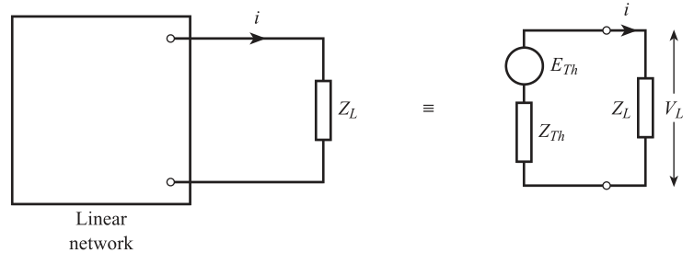
Thévenin Equivalent Electrical Loading

Slide 5
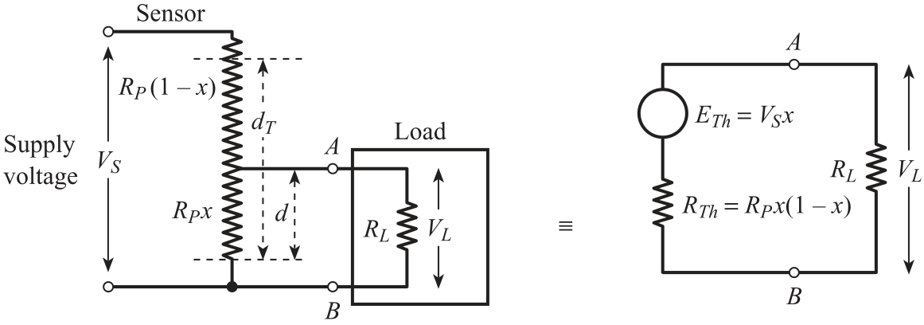
Thévenin Equivalent Circuit - Potentiometer Electrical Loading
Ex. Loaded Potentiometer

Slide 6
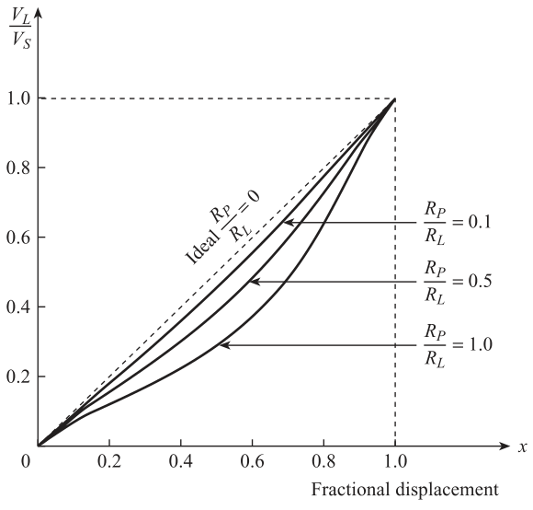

Thévenin Equivalent Circuit - Potentiometer Electrical Loading
Ex. Loaded Potentiometer
$$V_{L}=V_{S}⋅x⋅\frac{1}{\left(\frac{R_{P}}{R_{L}}\right)⋅x⋅\left(1−x\right)+1}$$

Slide 7
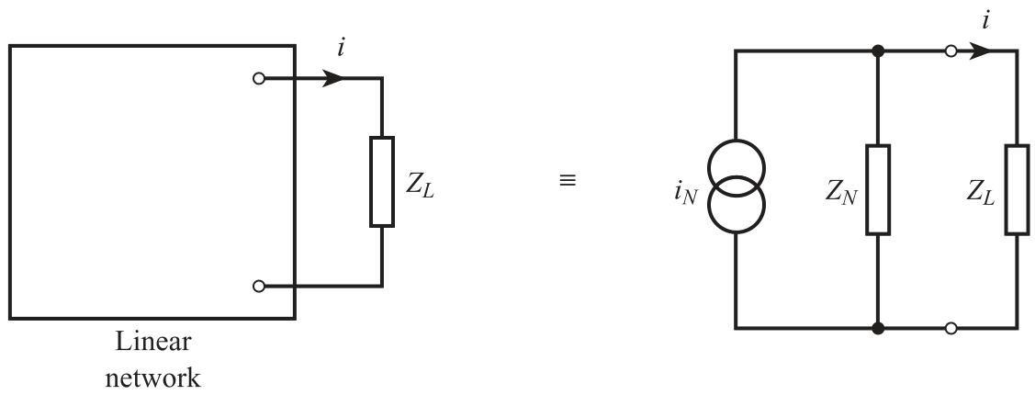
Nortion Equivalent Circuit Electrical Loading

Slide 8
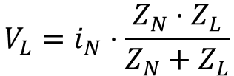
Nortion Equivalent Circuit Electrical Loading
$$V_{L}=i_{N}⋅\frac{Z_{N}⋅Z_{L}}{Z_{N}+Z_{L}}$$

Slide 9
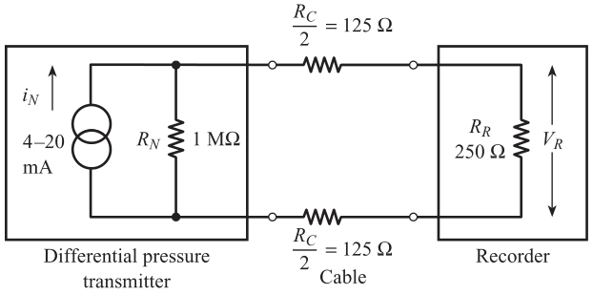
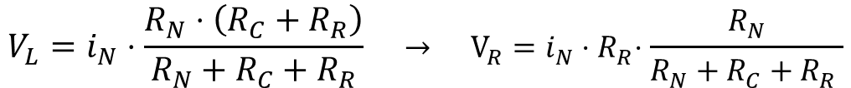

Nortion Equivalent Circuit Electrical Loading
$$V_{L}$$
$$V_{L}=i_{N}⋅\frac{R_{N}⋅\left(R_{C}+R_{R}\right)}{R_{N}+R_{C}+R_{R}} → V_{R}=i_{N}{⋅R}_{R}⋅\frac{R_{N}}{R_{N}+R_{C}+R_{R} }$$

Slide 10
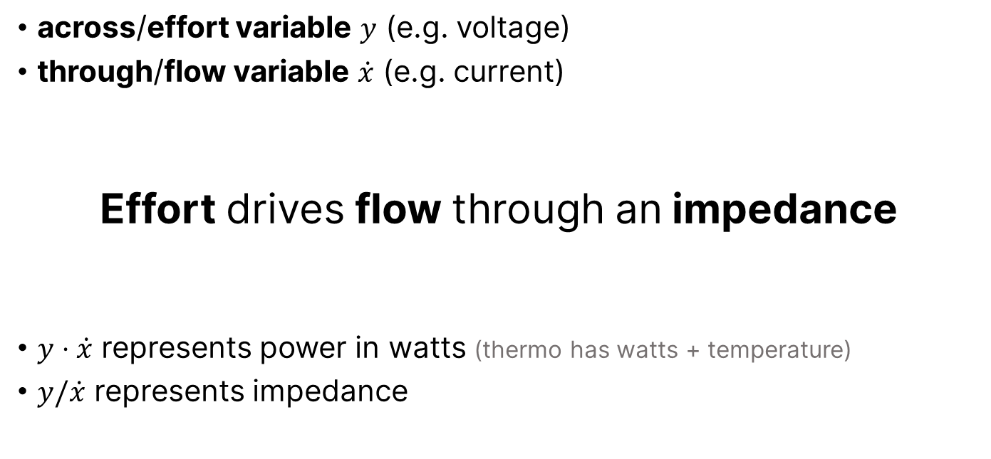
Generalized Effots & Flow Variables Two Port Networks
across/effort variable $y$ (e.g. voltage)
through/flow variable $\dot{x}$ (e.g. current)
Effort drives flow through an impedance
$y⋅\dot{x}$ represents power in watts (thermo has watts + temperature)
$y/\dot{x}$ represents impedance

Slide 11
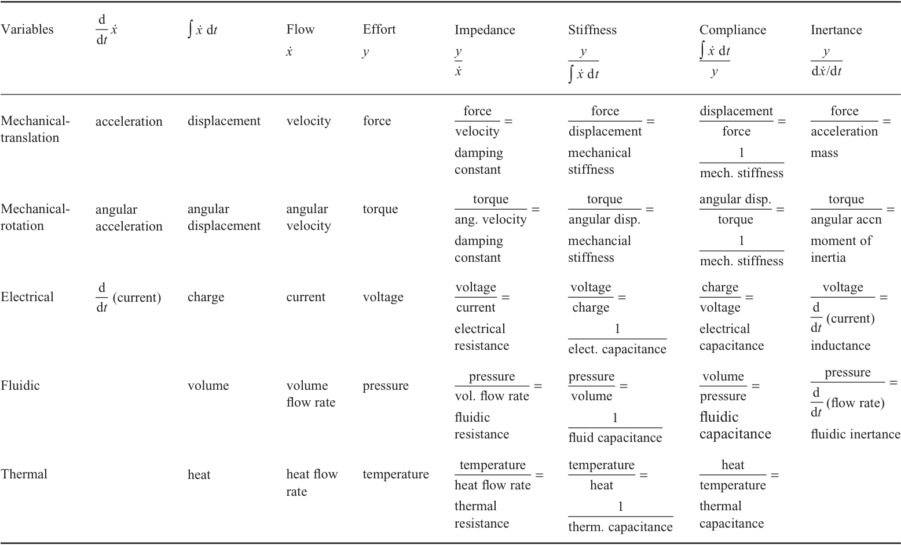
Two-port networks
Notes:
Flow & Effort Variables and related quantities → The Concept of impedance is applicable to mechanical, fluidic and thermal systems as well as electrical

Slide 12
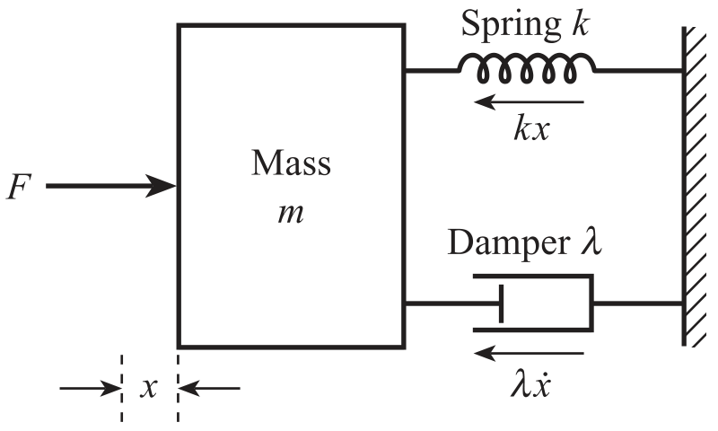
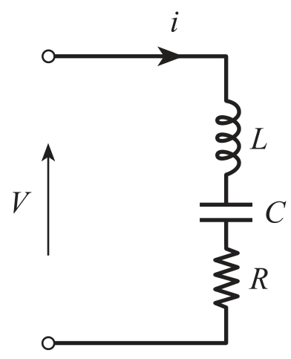

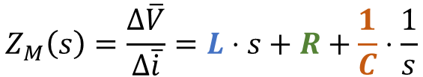
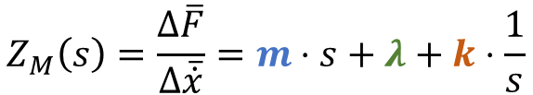
Generalized Effots & Flow Variables Two Port Networks
Parallel Mechanical System
Series Electrical circuit
$$Z_{M}\left(s\right)=\frac{Δ\overline{F}}{Δ\overline{\dot{x}}}=m⋅s+λ+k⋅\frac{1}{s}$$
$$Z_{M}\left(s\right)=\frac{Δ\overline{V}}{Δ\overline{\dot{i}}}=L⋅s+R+\frac{1}{C}⋅\frac{1}{s}$$
$$m\hat{=}L ; λ\hat{=}R ; k\hat{=}\frac{1}{C}$$

Slide 13
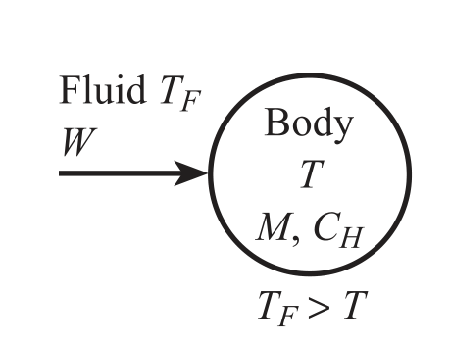
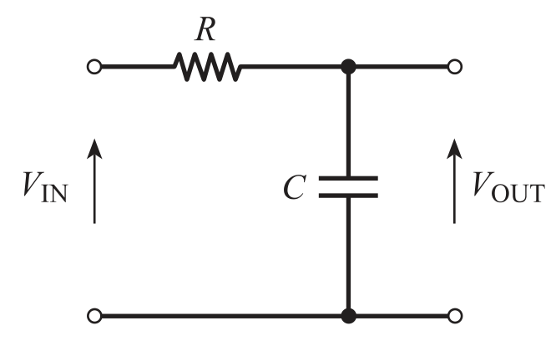


Generalized Effots & Flow Variables Two Port Networks
Thermal System
RC-Filter (electrical circuit)
$$M⋅C_{H}⋅\frac{dT}{dt}=U⋅A⋅(T_{F}−T)$$
$$C⋅\frac{dV_{OUT}}{dt}=\frac{1}{R}⋅(V_{IN}−V_{OUT})$$
$$T_{F}\hat{=}V_{IN} ; T\hat{=}V_{OUT} ; MC_{H}\hat{=}C ; UA\hat{=}\frac{1}{R}$$

Slide 14
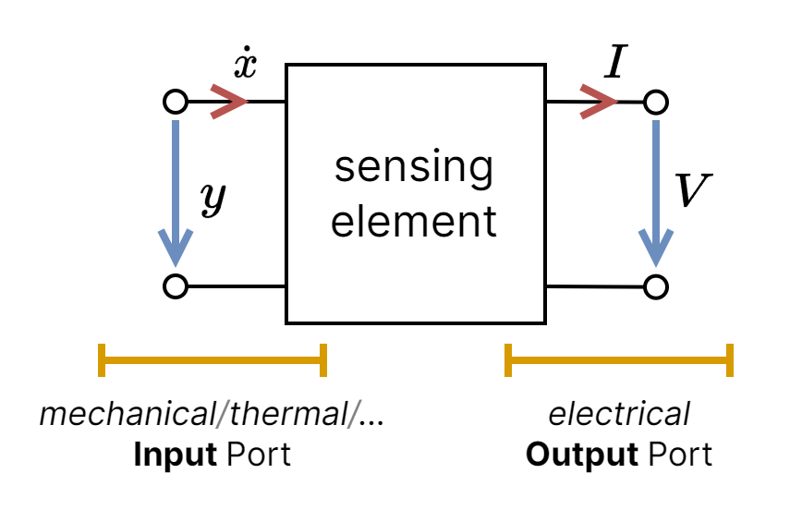
Two-port networks

Slide 15
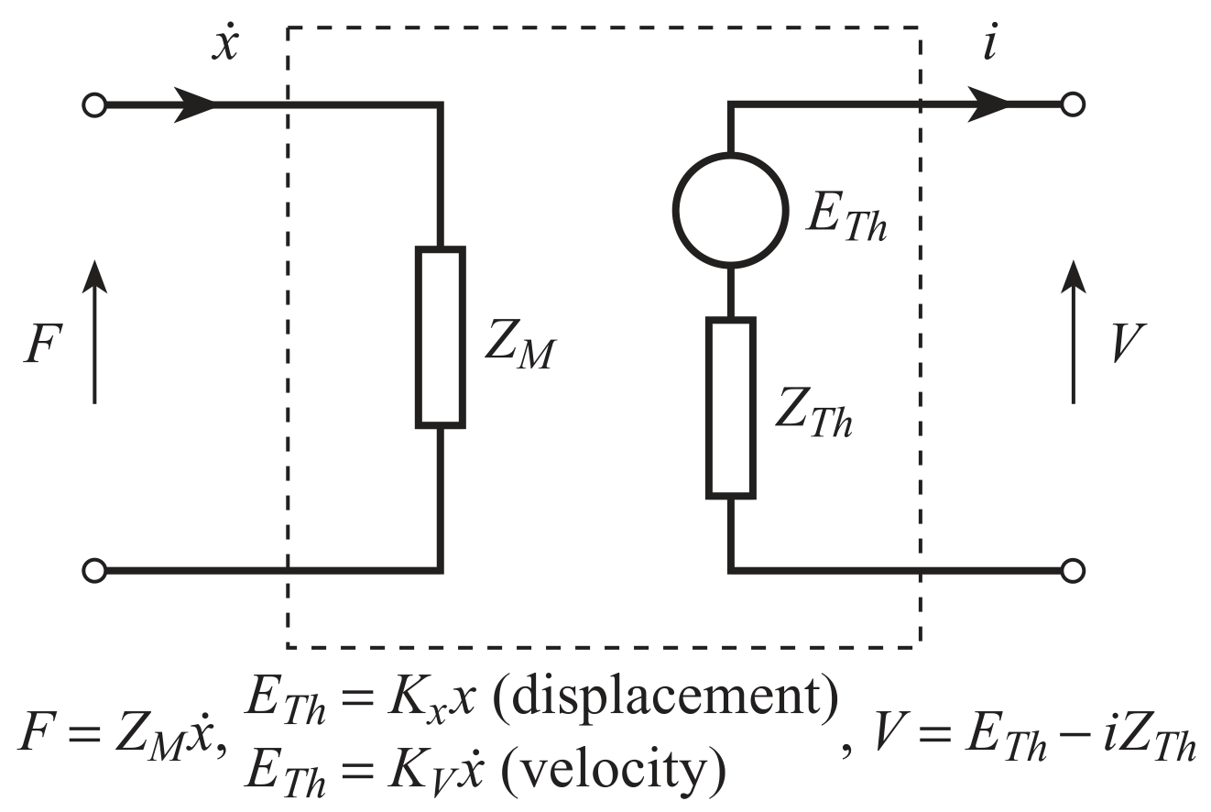
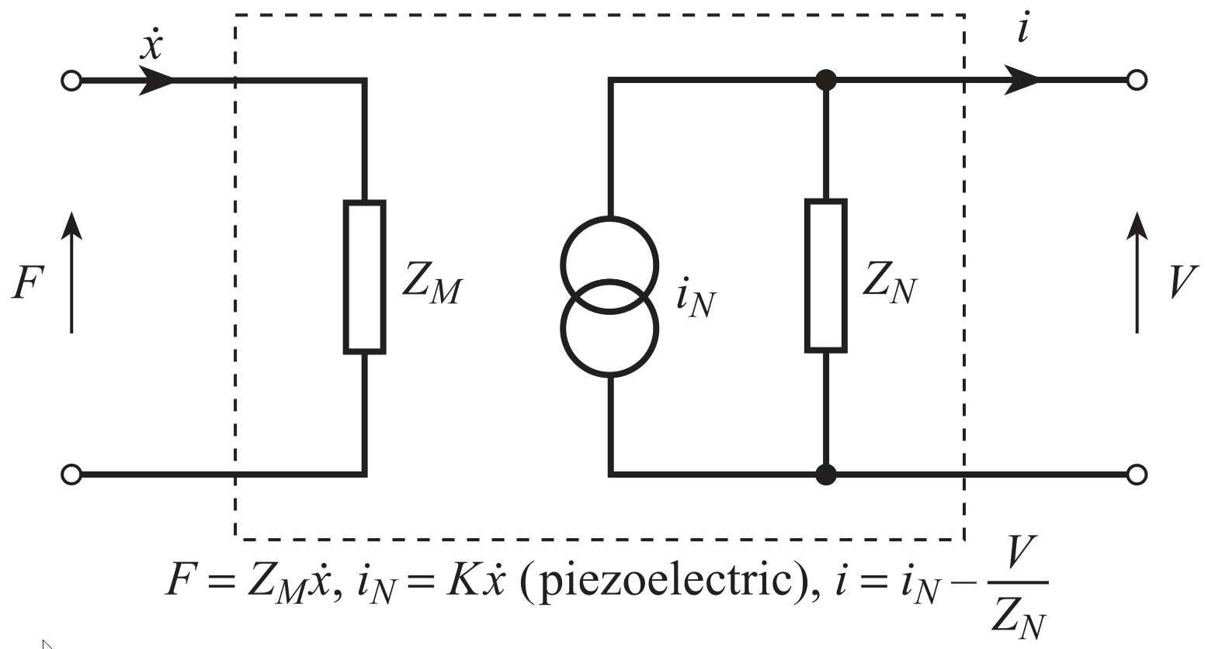
Mechanical Sensing Elements Two-port networks

Slide 16
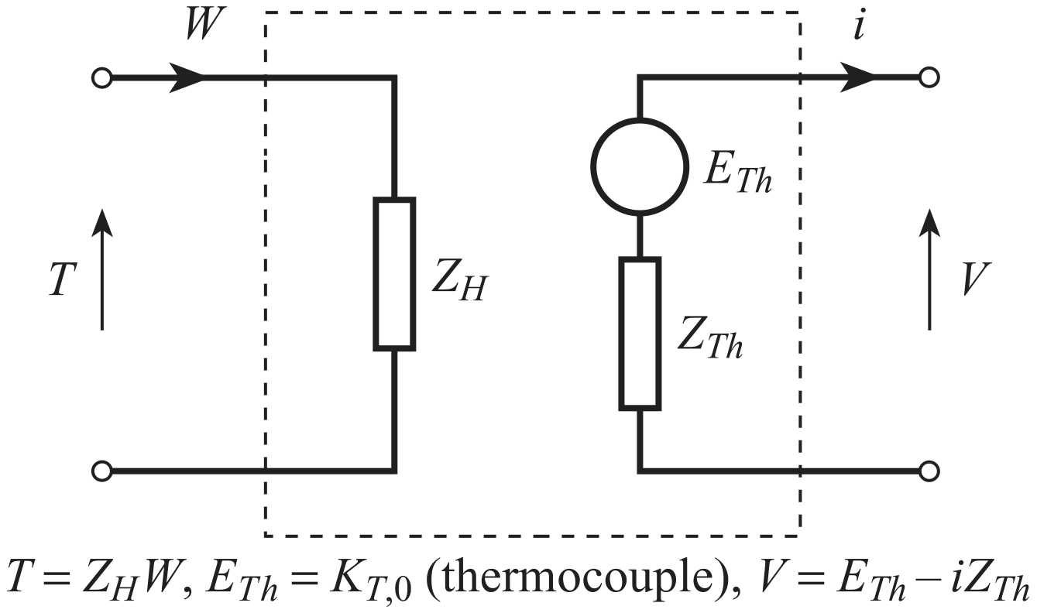
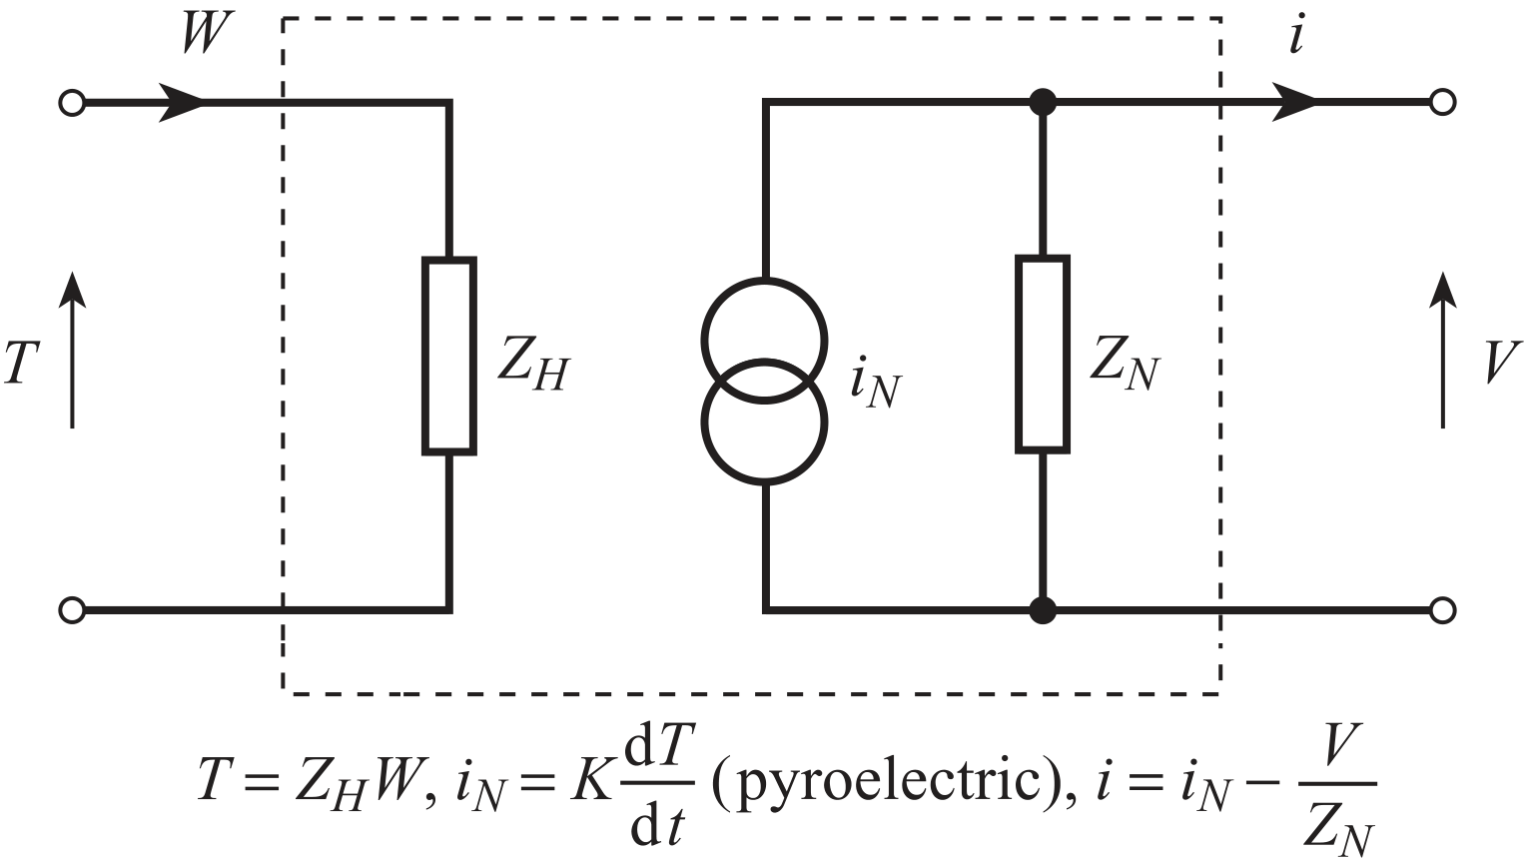
Thermal Sensing Elements Two-port networks

Slide 17
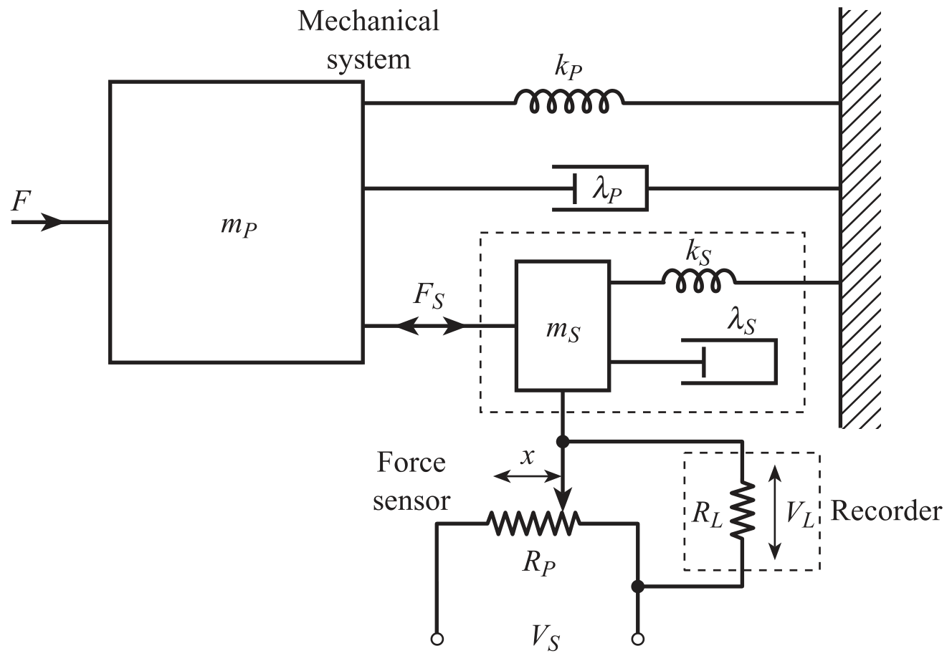
Process Loading Two-port networks
Notes:
LOADING ERROR, WHAT IS IT AND WHY DOES IT NEED TO BE CONSIDERED?

Slide 18


Process Loading Two-port networks
Process:
Sensor:
$F=k_{P}⋅x+F_{S}$
$F_{S}=k_{s}⋅x$
$$F_{S}=\frac{k_{s}}{k_{s}+k_{P}}⋅F=\frac{1}{1+\frac{k_{P}}{k_{s}}}⋅F$$
Steady-state
loading
Notes:
Process Loading is the concept of converting real inputs into measured inputs.
Since the sensor is going to have an influence on the process, the measured value needs to be correct.
The force balance equation leads to... → Deviations $\dot{x}=0$, $\ddot{x}=0$
...the following steady state loading equation → $k_{S}$ needs to be a lot bigger than $k_{P}$ → decrease in loading error

Slide 19
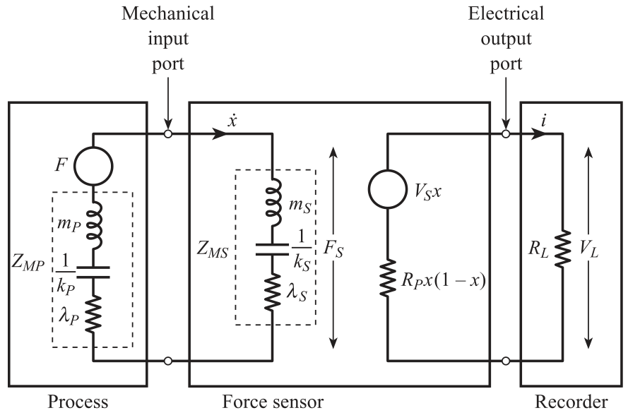

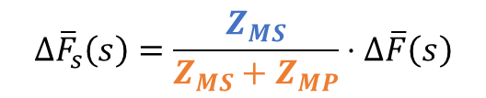
Process Loading Two-port networks
Process:
Sensor:
$$Δ{\overline{F}}_{s}\left(s\right)=\frac{Z_{MS}}{Z_{MS}+Z_{MP}}⋅Δ\overline{F}\left(s\right)$$
$F−k_{P}⋅x−λ_{P}⋅\dot{x}−F_{s}=m_{P}⋅\ddot{x}$
$F_{S}−k_{P}⋅x−λ_{P}⋅\dot{x}=m_{P}⋅\ddot{x}$
Dynamic
loading
Notes:
With the case of dynamic loading, the process needs to be adapted to said form.
Deviations $\dot{x}≠0$, $\ddot{x}≠0$ → Newtons Second leads to differential equations on the left.
By converting them into an electrical-equivalent circuit + Laplace → Dynamic Loading Equation
Dynamic Loading Error → $Z_{MS}$ needs to be bigger than $Z_{MP}$

Slide 20
Process Loading Two-port networks
Stuff left to do
Bilateral Transducers

Slide 21
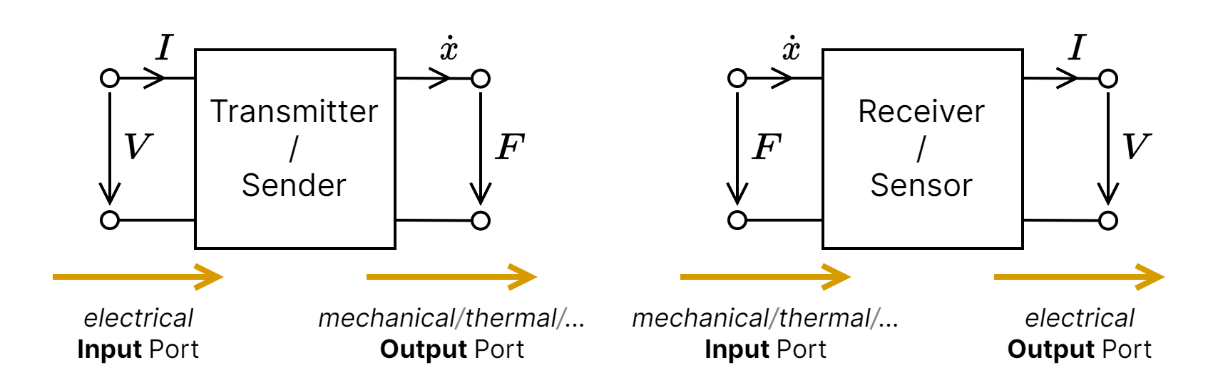
Bilateral Transducers Two-port networks
Examples: LEDs (Light Sensor/Source), Electromagnetic Effects, Deformation of Crystal
Notes:
bilateral transducers are associated with reversible effects $→for example Mechanical↔Electrical$

Slide 22
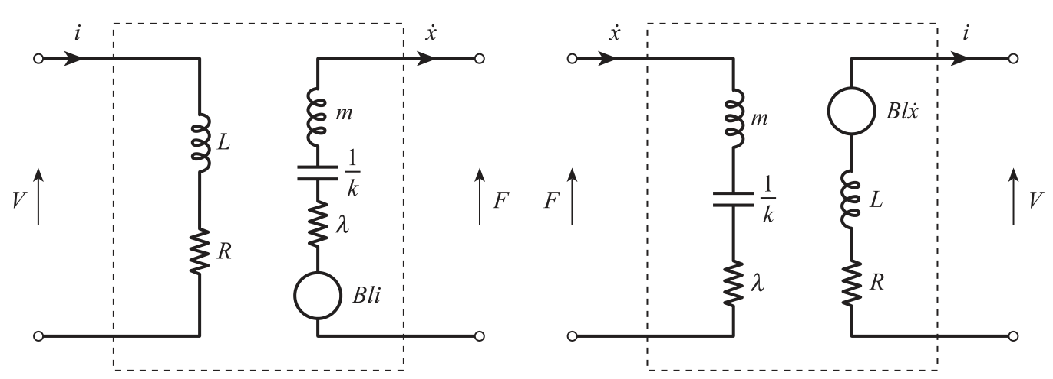
Bilateral Transducers Two-port networks
Transmitter/Sender
Receiver/Sensor
Notes:
bilateral transducers are associated with reversible effects $→for example Mechanical↔Electrical$

